Slide 1
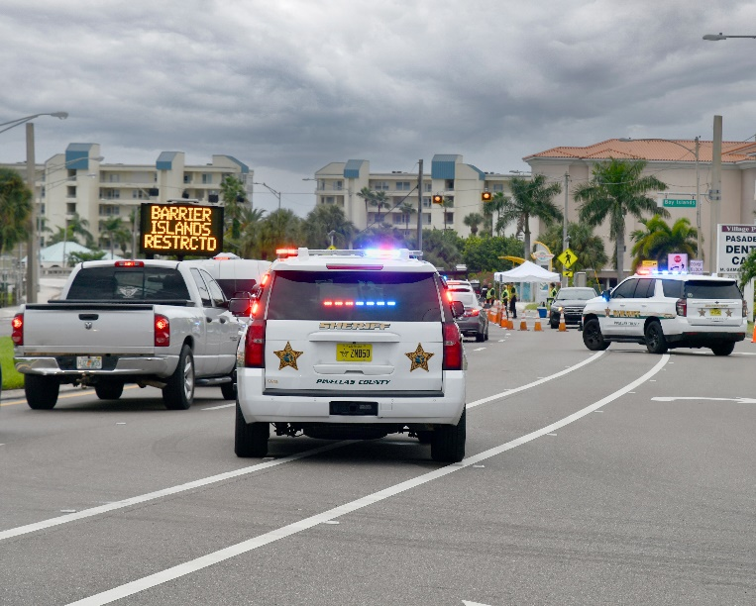
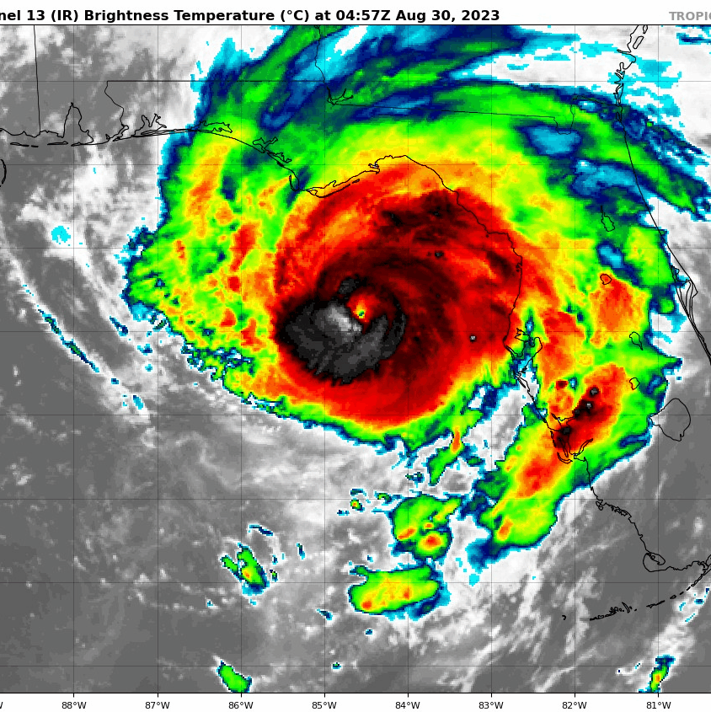
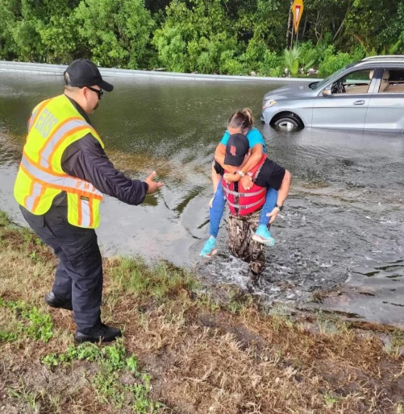
Welcome to Pinellas County Stephanie Hendrix, Planning and Preparedness Manager Emergency Management

Slide 2

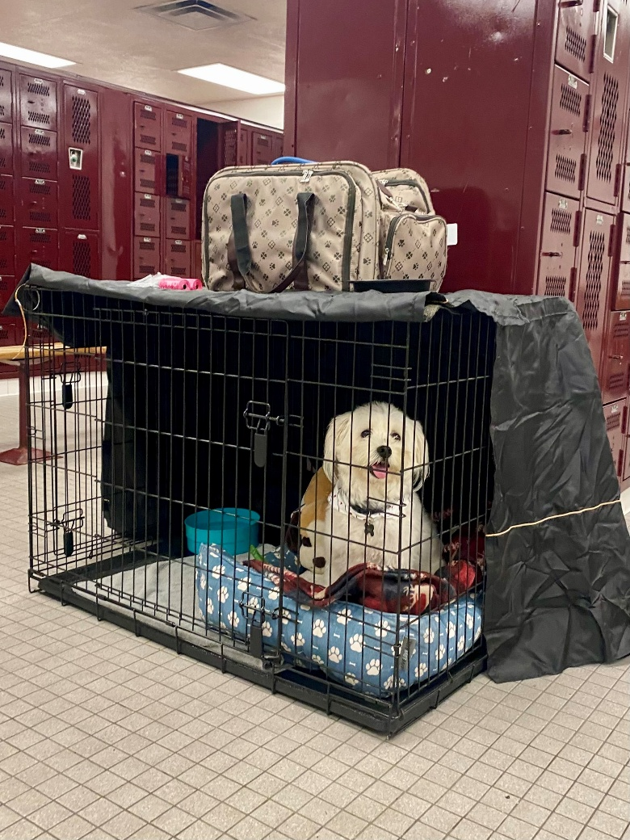
Hurricane Season Begins June 1
Know Your Risk
Make a Plan
Stay Informed
Get Involved

Slide 3
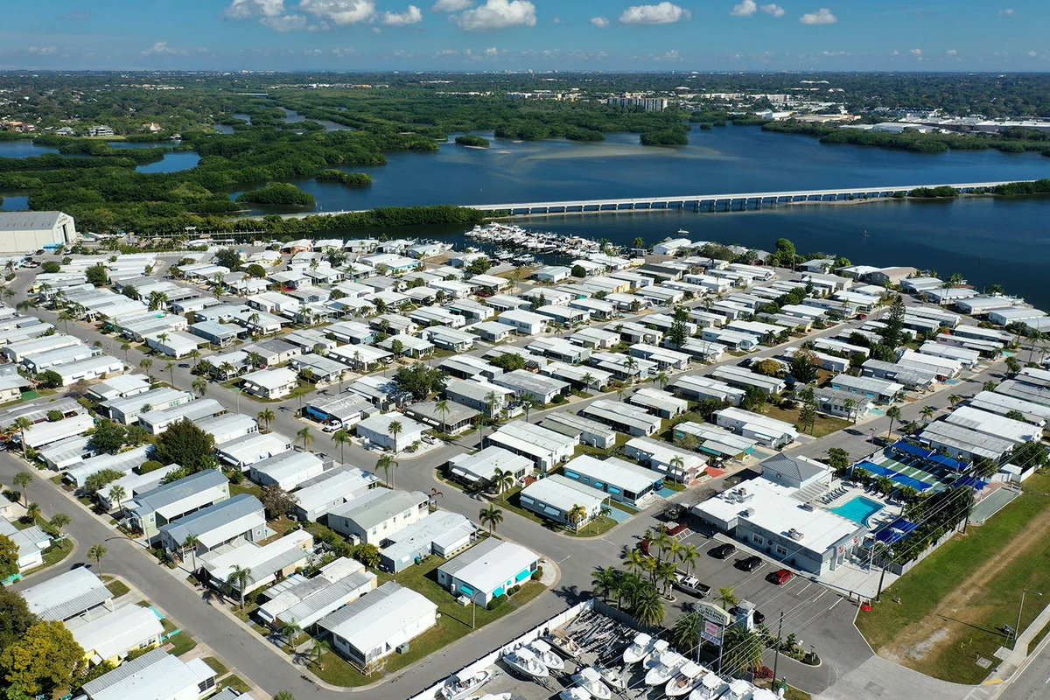
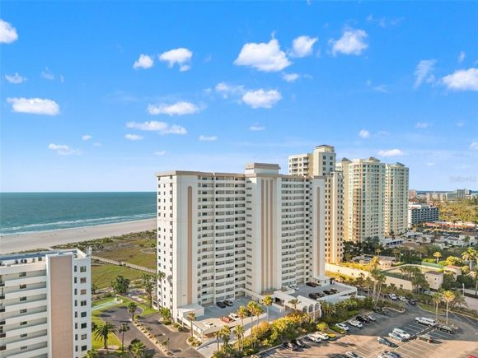
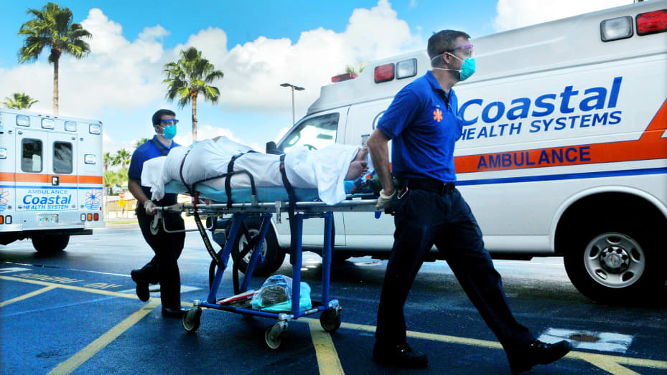
By the Numbers
24 municipalities - 18 fire districts
260 mobile home parks – 43,880 units
139 Assisted Living Facilities (76 in evac zones)
69 Nursing Homes (44 in evac zones)
17 hospitals (10 in evac zones)
3,881 people registered with special needs
Million residents ( 620+k in evac zones)
Thousands of tourists (14.9M a year)

Slide 4
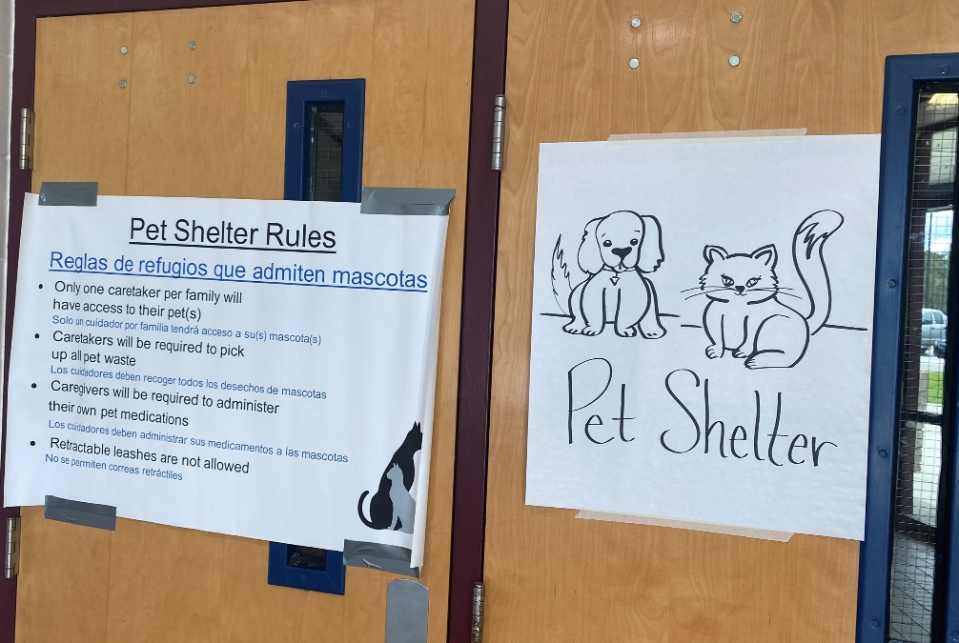
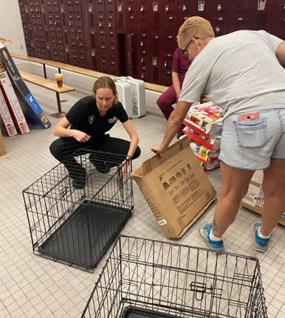
Pinellas Experience
Hurricane Debby
2 Community Centers Open
13 People 4 Pets
Hurricane Helene
6 Shelters Open
1,700 People 97 Pets
Hurricane Milton
12 Shelters Open
11,267 People 1,386 Pets

Slide 5
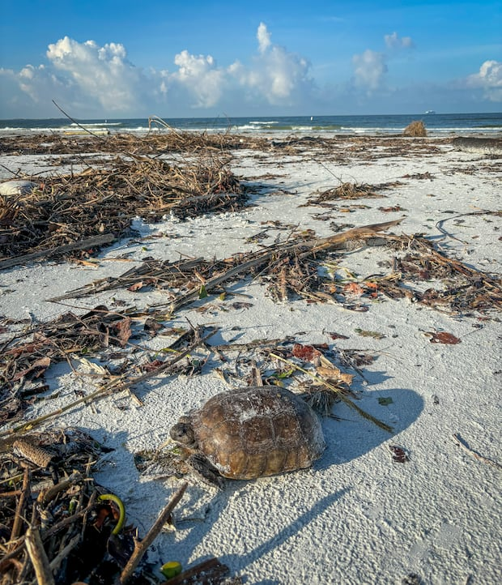
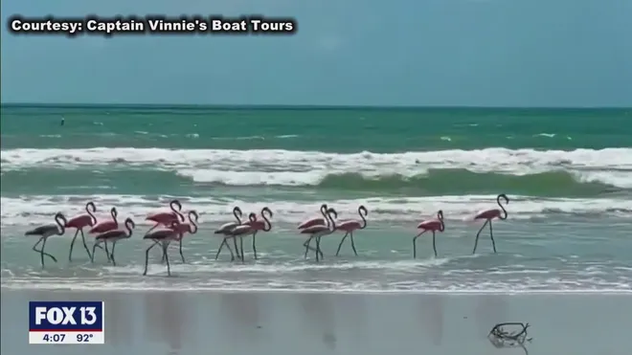
Surprise Guests
Hurricane Helene’s historic storm surge pushed dozens of Gopher Tortoises over 2 miles across open water from Egmont Key to Fort De Soto.
Hurricane Idalia’s strong winds carried flamingos to Pinellas Beaches, likely from Cuba

Slide 6
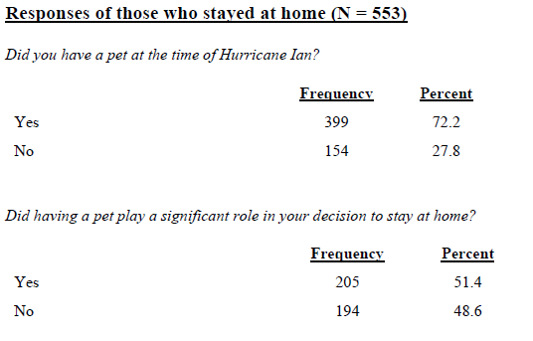

Survey
Hurricane Evacuation Decision Making in Pinellas County: A Study Focusing on Hurricane Ian (USF, January 2023)

Slide 7
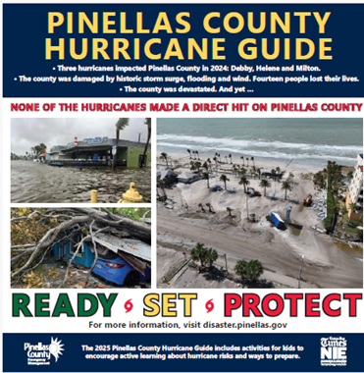


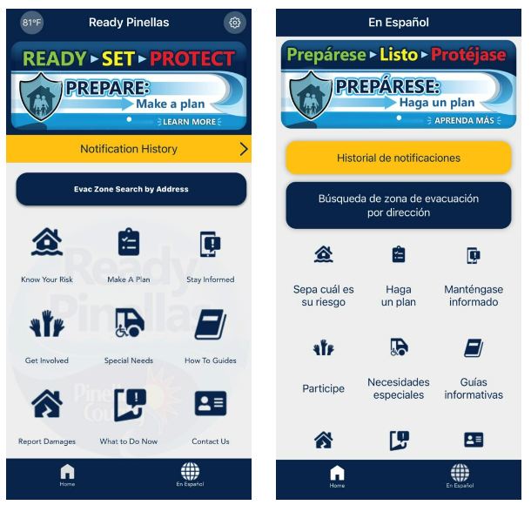

2025 Preparedness

Slide 8
Thank You
Stephanie Hendrix
Planning and Preparedness Manager
Pinellas County Emergency Management
shendrix@pinellas.gov

